Slide 1
Welcome to the Unified Government
Mayor, Commissioners, BPU Board, and Key Management Staff
David Alvey, Board President
Donald Gray, General Manager
Ed Cichanowicz, Independent Consultant
Dave MacGillivray, Springsted Incorporated
Kansas City Board of Public Utilities
12/12/2013

Slide 2
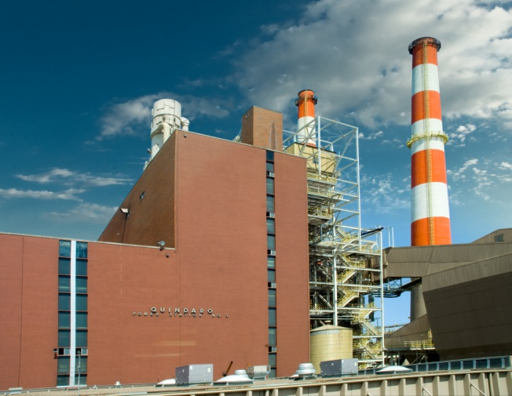
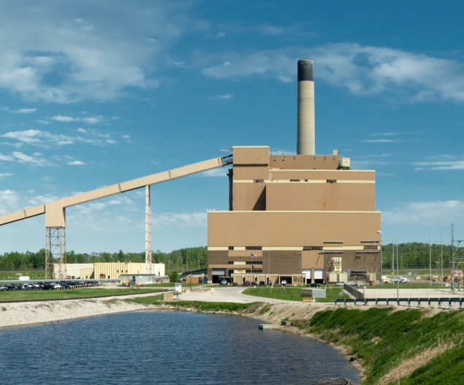
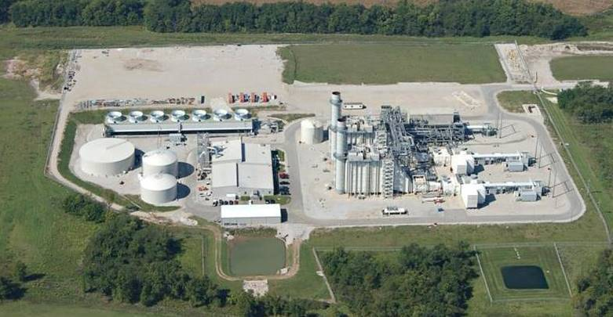
Current BPU Generation Mix
Quindaro Unit 1 – 1966
Quindaro Unit 2 – 1971
Combustion Turbine 1 – 1969
Combustion Turbine 2 – 1974
Combustion Turbine 3 - 1977
Nearman Unit 1 – 1981
Combustion Turbine 4 – 2006
2012 Dogwood Energy
17% Ownership) - 2002

Slide 3
Current BPU Generation Portfolio
Asset | Coal | Natural Gas | Oil | Renewables
Nearman 1 | 235 MW
Quindaro 1 | *75 MW | 75 MW
Quindaro 2 | *92 MW | 85 MW
Combustion Turbine 1 |  | 12 MW | 12 MW
Combustion Turbine 2 |  |  | 56 MW
Combustion Turbine 3 |  |  | 51 MW
Combustion Turbine 4 |  | 75 MW | 75 MW
Dogwood |  | 110 MW
Federal Hydro |  |  |  | 44.0 MW
Wind |  |  |  | 25.0 MW
Landfill Gas |  |  |  | 3.5 MW
Bowersock Dam |  |  |  | 7.0 MW
Renewables Total (16%) |  |  |  | 79.5 MW
* Q1/2 – gas only after April 2015

Slide 4
Issue
EPA issues a Federal mandate ordering all utilities to comply with a new Air Quality Control (AQC) standard.
  MATS - Mercury and Air Toxics Standards
  Finalized in April 2012
  Burn only gas after April 2015 without Air Quality Control (AQC)
  Or shut down all coal units after April 2015
Consent Decree between Sierra Club & BPU / UG
Burn gas at Quindaro after April 2015
Requires AQC to burn coal at Nearman after September 2017

Slide 5
Preparation
EPA mandates all utilities conform to new standards for AQC
BPU’s evaluated all solutions and identified three feasible options
BPU’s communicated impact of new EPA regs/required action to community for last 24 months
  BPU Strategic Plans highlighted issue for a decade
  Environmental updates in BPU Connection, presentations, etc.
  Dec 2012 – BPU presented issue at joint UG
  BPU presentations to Chamber, FIA, neighborhood groups, etc.
  June 2013 – Consent Agreement between BPU/UG and Sierra Club
  Sept 12, 2013 Joint BPU-UG Work Session on environmental issues
BPU must make a final decision to meet the compliance deadlines

Slide 6
Due Diligence
BPU polled all neighboring utilities within the SW Power Pool to evaluate their approach to the EPA mandate
BPU compiled detailed financial modeling of all possible solutions to determine three best possibilities
BPU developed a selection criteria profile to determine best solution
BPU consulted with national experts to validate best solution

Slide 7
Options for future BPU Energy Supply
Option # 1 = Purchase Power Agreements - eliminated
  Purchase majority of power/limited self-generation
Option # 2 = Generate with Natural Gas
  Convert Nearman 1 to gas or add gas turbines
Option # 3 = Generate with Coal
  Add Air Quality Control (AQC) upgrades to N1

Slide 8
Pros / Cons
 | Option #1, Purchase Power Agreement to import/limited self generation - ^{eliminated} | Option #2, Natural Gas Conversion, convert N1 to gas/gas turbine | Option #3, Coal with Air Quality Control (AQC) to Nearman
Capital Costs | 0 | $100 M (includes SCR) | $250 M
Advantages | • No capital costs • No maintenance costs • No environmental costs | • Lower capital costs • BPU owned and controlled • Lower maintenance costs • Less overall environmental impact • Protects economic development | • BPU owned and controlled • Stable fuel price • Fuel flexibility across fleet • On-site fuel storage • Protects economic development • Increases staff • Cost recovery through market sales • Meets future environmental compliance
Disadvantages | • Stranded capital costs • Transmission limitations and costs • Limited PPA availability • PPA price risk volatility • No direct control • Loss of economic development initiative • Capacity purchase • Reduction in staff employment | • Higher generation costs • Natural gas price volatility • Interruptible gas supply • Reduced utilization (<25%) and market sales • Loss of fuel flexibility • No on-site fuel storage | • Higher maintenance costs • Risk of additional anti-coal environmental regulations

Slide 9
Surrounding Utilities Are Installing Air Quality Control
Plant | ST | Unit | Year in Service | Cost
Westar – Lawrence* | KS | 3,4,5 | 54,60,71 | $300 M
Westar – Jeffrey* | KS | 1,2,3 | 78,80,83 | $500 M
KCP&L – La Cygne* | KS | 1,2 | 73,77 | $1.2 B
KCP&L – Iatan* | MO | 1 | 80 | $300 M
Empire – Asbury* | MO | 1 | 70 | $108 M
PSC OK – Northeastern** | OK | 4 | 80 | $400M
SWEPCO – Flint Creek** | AR |  | 78 | $408 M
IP&L – Ottumwa** | IA | 1 | 81 | $345 M
IP&L – George Neal* | IA | 3,4 | 75,79 | $280 M
IP&L – Lansing** | IA | 4 | 77 | $180 M
Alliant – Columbia** | WI | 1,2 | 75,78 | $627 M
Alliant – Edgewater | WI | 5 | 85 | $550 M
LG&E – Trimble Co. | KY | 1 | 90 | $250 M
LG&E – Mill Creek** | KY | 1,2,3,4 | 72,74,78,82 | $1.0 B
IPL – Petersburg/Harding** | IN | 1,2,3,4 | 67,69,77,86 | $400 M
Average |  | 28 Units |  | $245 M
BPU - Nearman | KS | 1 | 1981 | $250 M
Nearman is newer than 80% of units that have be retrofitted to meet AQC
Average compliance costs are in line with surrounding utility projects
* - Completed
** - In progress
Notes:
Right before the conclusion
9

Slide 10
Relevant Case Study
In 2011 we performed an extensive study of forthcoming environmental regulations, followed by an economic evaluation of options available. As a result of this evaluation, City Utilities proceeded with environmental AQC upgrades on John Twitty Unit #1 (1976, 187MW), and James River Unit #4 (1964, 56 MW) and Unit #5 (1970, 97MW).
We also committed 3 small dual-fuel units to burn only natural gas. Due to the size and inefficiencies of these units they are rarely used.
City Utilities of Springfield, MO

Slide 11
Options Cost Comparison
 | Coal - Current | Option #1 Purchase Power Agreement | Option #2 Gas –Average Price Over 10 Years ($5.79) | Option #3 Coal – AQC (based on 2017 O&M)
Annual Generation Cost | $63 M | $120 M | $127 M | $96 M
Annual Increase | - | $57 M | $64 M | $33 M
$/MWHr | $38.57 | $73.77 | $77.96 | $58.65
Residential Average | 0 | $ 25 /month increase | $ 30 /month increase | $ 12 /month increase

Slide 12
Selection Criteria Profile
Numerous factors considered when choosing best solution to comply with EPA AQC:
Cost implications to citizens (near-term/long-term)
Reliability of solution
Volatility of solution in terms of input pricing
Stability/predictability of solution (10yr., 20 yr., 30yr.)
Protection of service from outside influences (catastrophe, outside infrastructure, etc.)
Financing – probability, timing, cost
BPU’s long-term strategic plan
BPU / UG’s decree with the Sierra Club
History

Slide 13
Recommended Option…
Option #3 = Coal with AQC Upgrades
Short and long-term price stability (lowest cost to citizens)
Reliability of power supply
Least impact of input fuel volatility
Ensures long-term power solution for WyCo
Mitigates threat of outside catastrophes impacting BPU power supply
Favorable bonds markets (outside speaker will address)
Aligns with BPU’s long-term fuel diversification and master plan
Satisfies UG/BPU legal agreement with the Sierra Club
Wyco’s benefited from self-owned generation for 100 years.

Slide 14
External Recommendation: Option #3
Ed Cichanowicz – Engineering Consultant, Los Gatos, CA

Slide 15
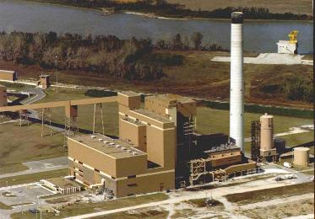
AGENDA
Why Invest In Nearman?
Risks of AQC Investment
  Cost
  Additional mandates
  Role of CO₂
Alternatives
  Natural gas switch
  Combined cycle
  Wind
Recommendation

Slide 16
Nearman: Key, City-Owned Asset
Benefit: Least Cost Power Source
Fuel | Action | Capital ($M) | Fuel Price ($/MBtu) | Power Cost ($/MWh)
Coal | Retrofit Nearman with AQC | 250 | 2 | 58
Natural Gas | Switch Nearman to Gas, Partial AQC | 100 | 4-6 | 58-80
Natural Gas | New Combined Cycle Unit | 312 | 4-6 | 56-70

Slide 17
Nearman: Key, City-Owned Asset (cont’d)
Benefit: Reliable, Stable Power Prices for Decades
Competitive, Efficient Unit in the Southwest Power Pool
Reliable and Used a Lot
  Availability: ~86-90%
  Capacity factor: ~80%
Capacity (235 MW) Exploits Economies-of-Scale
Significant Lifetime Remaining: 25+ years
Stable Fuel Price

Slide 18
Stable Fuel Price = Stable Power Price
$/MBtu

Slide 19
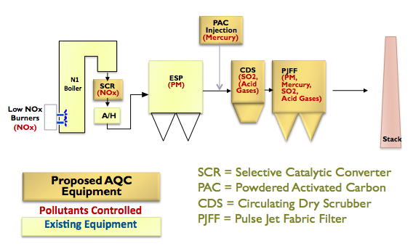
Investment Risk (1): Cost

Slide 20
Investment Risk (1): Cost
Selective Catalytic Reduction:
130,000 MW

Slide 21
Investment Risk (1): Cost
Selective Catalytic Reduction:
130,000 MW
Powdered Activated Carbon: 50,000 MW

Slide 22
Investment Risk (1): Cost
Selective Catalytic Reduction:
130,000 MW
Powdered Activated Carbon: 50,000 MW
Flue Gas Desulfurization 175,000 MW

Slide 23
Investment Risk (1): Cost
Selective Catalytic Reduction:
130,000 MW
Powdered Activated Carbon: 50,000 MW
Flue Gas Desulfurization 175,000 MW
“Pulse-Jet”
Fabric Filter
40,000 MW

Slide 24
Investment Risk (2):
More Environmental Mandates?
Any Additional Mandates Manageable
AQC Elevates Nearman to “State-of-Art”
EPA Must Base New Limits on “Best” Technology
Federal Rule | Pollutant(s) | “Best” Technology | Nearman AQC
Mercury and Air Toxics (MATS) | Mercury, acid gases, particulate | Activated carbon and pulse jet fabric filter | Activated carbon and pulse jet fabric filter
Cross State Air Pollution Rule | NOx | Selective catalytic reduction | Selective catalytic reduction
 | SO₂ | SOA flue gas desulfurization | SOA flue gas desulfurization

Slide 25
Investment Risk (3): CO₂
CO₂ Emission Limits for Existing Units to Be Proposed by June 1, 2014
EPA Anticipated to Reduce CO₂ by Plant Efficiency Improvements – likely <5%
Nearman No More/Less Disadvantaged Than Other Competitive Units
  Nearman Unit 2: 2,400 lbs CO₂/MWh
  Approximates national average
Numerous Efficiency-Improving Options Applicable

Slide 26
How Do Other Options Compare?
Switch Nearman to Natural Gas
  $100M – catalytic reactor, burners, larger gas pipeline
  Boiler not designed for gas heat – low efficiency
  Unit will not “compete” in wholesale market
  Natural gas price risk
Build New Natural Gas Plant (Combined Cycle)
  More capital than AQC: $306 M
  Power only competitive with gas at today’s price
    $ 4/MBtu: same (within 5%) as coal
    $ 6/MBtu: 20% higher than coal

Slide 27
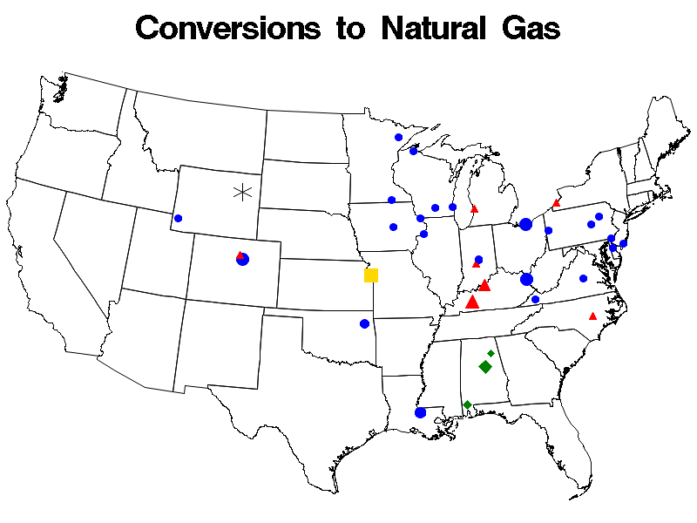
Smaller Units with Less Favorable Coal Supply Switching to Gas
Gas Switch
Combined Cycle
Gas w/Coal Backup

Slide 28
Smaller Units with Less Favorable Coal Supply Switching to Gas
All But One Unit < 125 MW
Gas Switch
Combined Cycle
Gas w/Coal Backup

Slide 29
More Options: Wind?
50 MW Operating or Planned
BPU Voluntarily to Meet 20% Renewables by 2020
Significant Investment: Two Generating Facilities
  Need both wind “farm”, new combined cycle plant
    Wind capacity factor ~ 30-35%
    Combined cycle plant for backup
Grid Will Require Upgrade as Wind Fraction Surpasses 20%

Slide 30
Conclusion
Nearman Unit 1: Basis for Reliable Power Portfolio
Few Better Locations than KC for Base-loaded Coal
  Relatively proximity to low sulfur coal sources
  Good transportation infrastructure
Natural Gas
  Important contributor to power portfolio
  Price risk for base load
Stable Fuel Prices = Stable Power Prices

Slide 31
Unified Government / Board of Public Utilities (BPU) Issuance
Dave MacGillivray– Springsted, Inc.
Unified Government: issuer for BPU bonds
Springsted: independent financial advisor for the UG/BPU
Springsted relationship longstanding
Our objective/role: provide objective advice to all decision makers
UG & BPU: substantial financial interconnections

Slide 32
Marketability
Marketability of the bonds: $250M over three years
Phased program $100M in 2014 and 2015 and $50M in 2016
Electric utilities, the individual and total amount(s) not that large
Senior underwriter and Springsted believe good marketability
Market interest rates
Good Credit Ratings at A2, A+, A+
Scarcity of Kansas bonds
Current interest rates are still historically low

Slide 33
Community Indebtedness (UG & BPU)
UG Indebtedness related to GO only*: $320M
BPU Indebtedness*: $500M (Bonds and Loans)
Comparative: Source – rating agencies
  Unified Government Ratings:
  S&P: AA(Stable, Moody’s: Aa3 (Negative
  Unified Government Rating Report Language on Debt
  S&P: ‘Moderate to high overall debt burden’
  Moody’s: ‘High debt burden expected to remain manageable due to some non-levy support’
  *As of December 31, 2012 Audited Financials

Slide 34
Credit Rating
BPU Rating Report Language on Debt
Fitch A+: Anticipate $200-$300M, no concern given user rate increase plan executed
Standard & Poor’s A+: No debt discussion other than noting ‘coverage’ strong at 1.60X
Moody’s A2: Anticipate these borrowings
  Note: ‘Leverage (debt) supposed to rise above 50% in 2011 to below 65% but still within (BPU) policy levels’

Slide 35
Credit Ratings Change
Don’t control this so no guarantees: Three Agencies
Moody’s Negative Outlook, Others Stable
Challenges to ratings:
Liquidity
Socio-economic profile of customer base, recognizing new development
Many Positives
Regular user rate increases and rate structure (cost recovery and no state rate approval)
Key rating driver
Maintain user rate program, recognizing competitiveness

Slide 36
Questions & Answers

